Slide 1
FLIP : Cross-domain Face Anti-Spoofing with Language Guidance
URINOV AZIZBEK (연구원), 2025.02.07, KII-FAS SEMINAR

Slide 2
Contents :
Why ‘FLIP : Cross-domain Face Anti-Spoofing with Language Guidance’ title ?
What is FLIP framework ?
What is FLIP_V (FLIP-Vision) strategy ?
What is FLIP_IT (FLIP-Image-Text-Similarity) strategy ?
What is FLIP_MCL (FLIP-Multimodal-Contrastive-Learning) strategy ?
FLIP Framework Evaluation
Conclusion and Problems
URINOV AZIZBEK (연구원), 2025.02.07, KII-FAS SEMINAR

Slide 3
Why ‘FLIP : Cross-domain Face Anti-Spoofing with Language Guidance’ title ?
URINOV AZIZBEK (연구원), 2025.02.07, KII-FAS SEMINAR

Slide 4
FLIP : Cross-domain Face Anti-Spoofing with Language Guidance
Let’s split the title …
?
2
1
3
URINOV AZIZBEK (연구원), 2025.02.07, KII-FAS SEMINAR

Slide 5
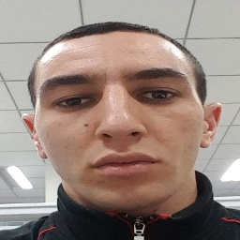
FLIP : Cross-domain Face Anti-Spoofing with Language Guidance
1
Classification tasks
Regression
Clustering
Anomaly Detection
Ranking
Recommendation
Forecasting
Object Detection
Binary Classification
Multiclass Classification
Image Classification
Face Anti-Spoofing (FAS) : Why ?
Machine Learning (ML)
REAL (1)
SPOOF (0)
URINOV AZIZBEK (연구원), 2025.02.07, KII-FAS SEMINAR

Slide 6
FLIP : Cross-domain Face Anti-Spoofing with Language Guidance
2
Google : What is domain in DL?
Google : In deep learning, a "domain" refers to a specific area or context of data with a particular distribution
DOMAIN
In-domain
Model TRAINING and
TESTING domain is the
same.
Cross-domain
Model TRAINING and
TESTING domain is NOT
the same.
So what can be ‘domain’ in FAS task?
Camera : mobile, webcam, sensor devices, etc
Environment : lighting variations, darkness, etc.
Spoofing Attacks: printed photo,
replay attack, 3D masks , etc
This is our primary task. Because we don’t
know the exact domain (user attack types
2D/3D, environment, different devices,etc).
URINOV AZIZBEK (연구원), 2025.02.07, KII-FAS SEMINAR

Slide 7
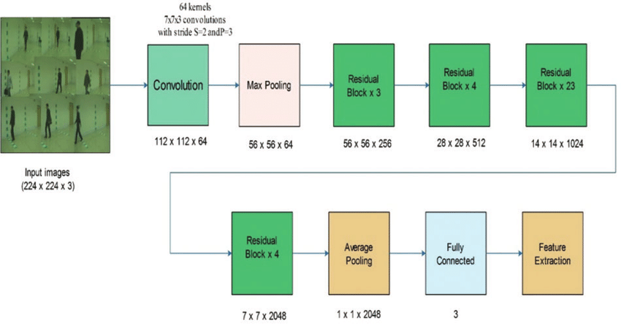
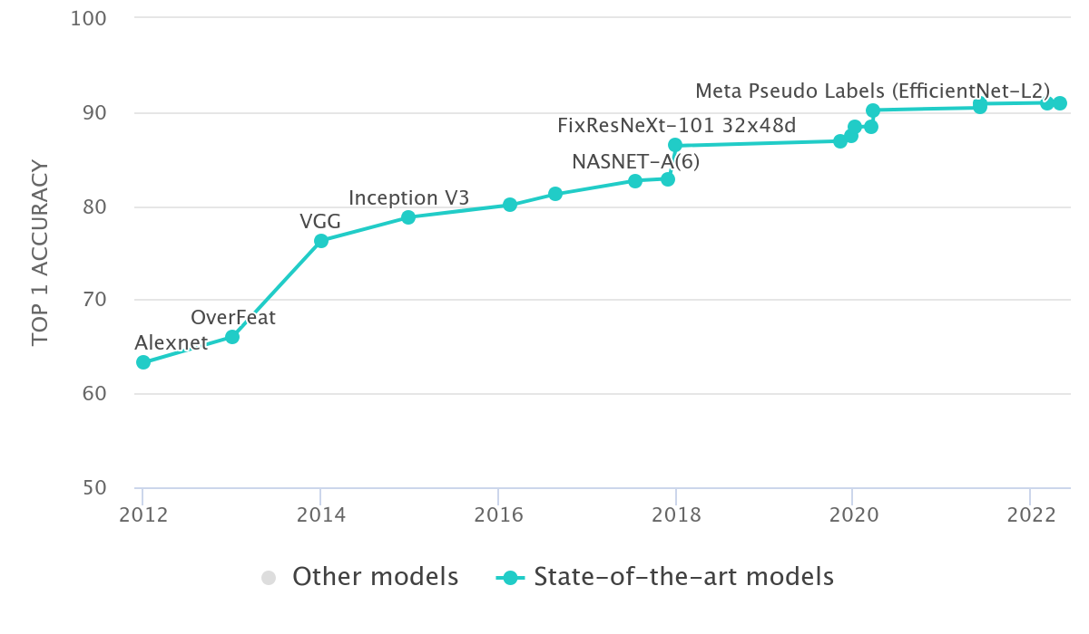
FLIP : Cross-domain Face Anti-Spoofing with Language Guidance
3
Image Classification with ResNet-101 Image Classification on ImageNet
URINOV AZIZBEK (연구원), 2025.02.07, KII-FAS SEMINAR

Slide 8
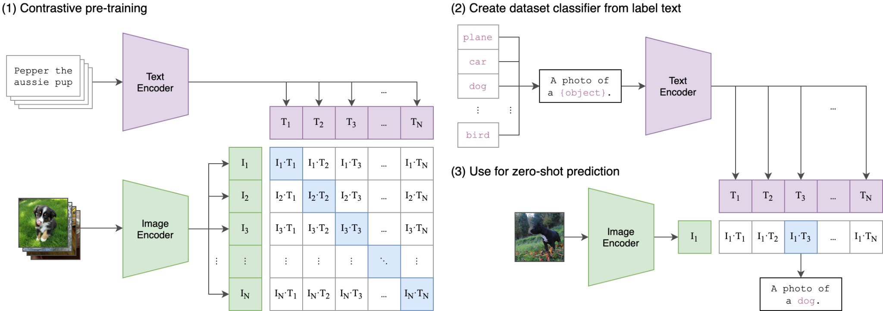
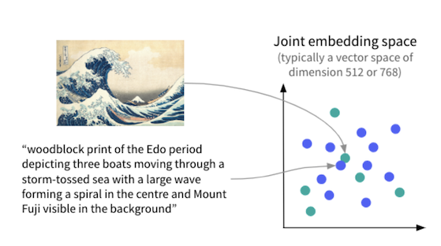
FLIP : Cross-domain Face Anti-Spoofing with Language Guidance
3
Image Classification with CLIP based mode (by OpenAI)
Simple view of vector space
URINOV AZIZBEK (연구원), 2025.02.07, KII-FAS SEMINAR

Slide 9
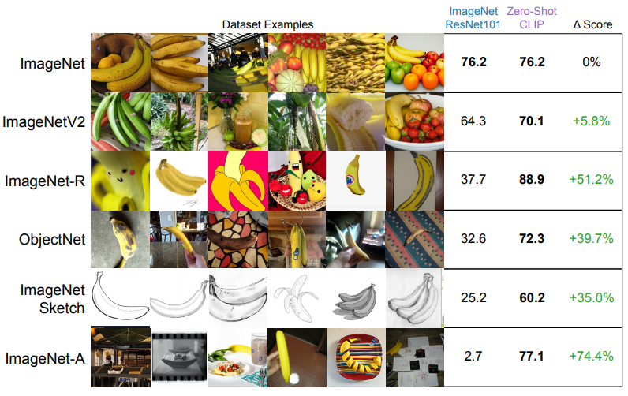
FLIP : Cross-domain Face Anti-Spoofing with Language Guidance
3
URINOV AZIZBEK (연구원), 2025.02.07, KII-FAS SEMINAR

Slide 10
FLIP : Cross-domain Face Anti-Spoofing with Language Guidance
?
Camera : mobile, webcam,
sensor devices, etc
Environment : lighting
variations, darkness, etc.
Spoofing Attacks: printed
Photo, replay attack, 3D
masks , etc
REAL (1)
SPOOF (0)
The classification task in face anti-spoofing, combined with cross-domain learning and language guidance, can help us
develop a new method called ‘FLIP’.
?
URINOV AZIZBEK (연구원), 2025.02.07, KII-FAS SEMINAR

Slide 11
2. What is FLIP framework ?
URINOV AZIZBEK (연구원), 2025.02.07, KII-FAS SEMINAR

Slide 12
FLIP : Cross-domain Face Anti-Spoofing with Language Guidance
?
Face Anti-Spoofing Classification task :
ViT (Vision Transformers)
(ability to capture long range dependencies among image patches)
CNN (Convolutional Neural Networks)
Hybrid (CNN + ViT)
Possible problems :
Domain Adaptation and Few-shot Learning : we need labeled / unlabeled data to TRAIN.
Domain Generalization : complexity and additional
information. (split style and content to TRAIN the models)
Vision Language Pre-training : ? In order to find out CLIP (OpenAI) based FLIP (Face Anti-Spoofing Language-Image Pretraining) for cross-domain framework promised with 3 strategies : FLIP-V, FLIP-IT and FLIP-MCL.
Problem : How we can use ViT s on cross-domain?
Related Work (possible solutions) :
Domain Adaptation and Few-shot Learning
Domain Generalization
Vision Language Pre-training
URINOV AZIZBEK (연구원), 2025.02.07, KII-FAS SEMINAR

Slide 13
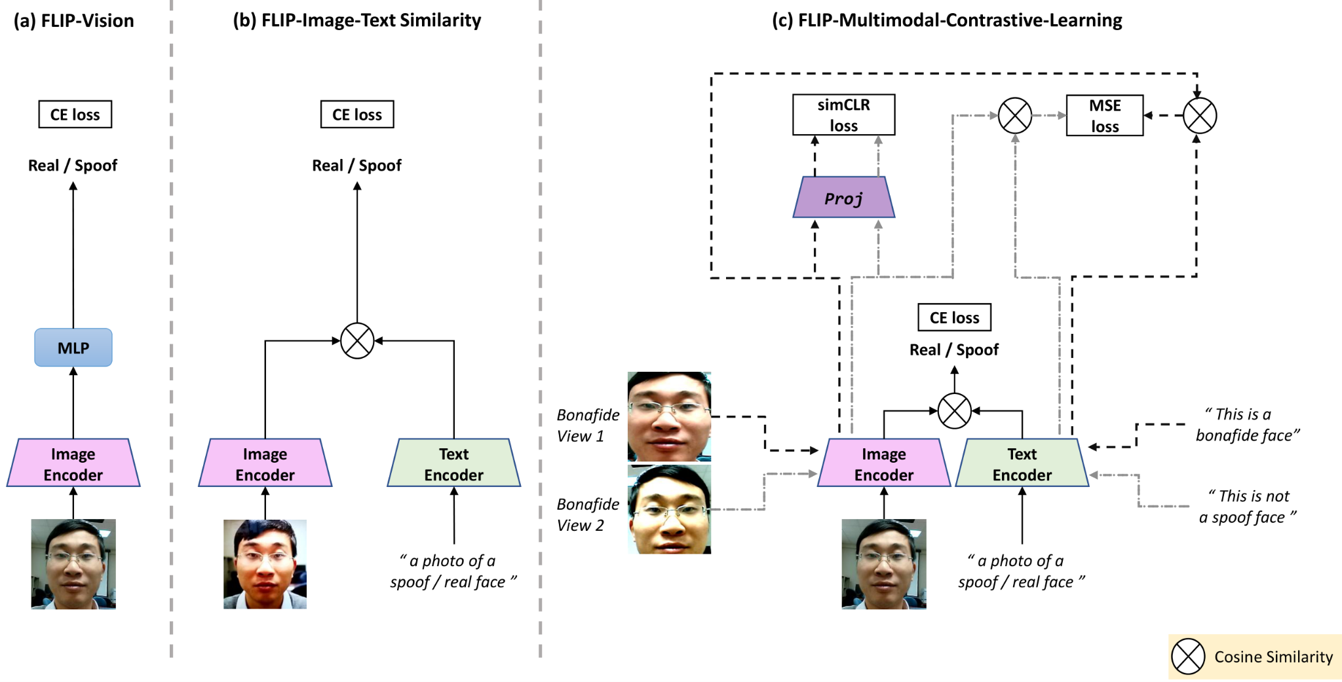
FLIP : Cross-domain Face Anti-Spoofing with Language Guidance
CLIP (Contrastive Language-Image Pre-Training)
t
I ∈ R ** H×W×3
URINOV AZIZBEK (연구원), 2025.02.07, KII-FAS SEMINAR

Slide 14
3. What is FLIP_V (FLIP-Vision) strategy ?
URINOV AZIZBEK (연구원), 2025.02.07, KII-FAS SEMINAR

Slide 15
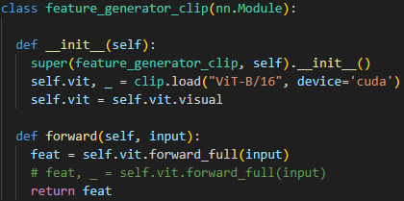
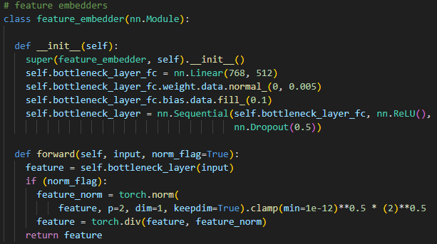
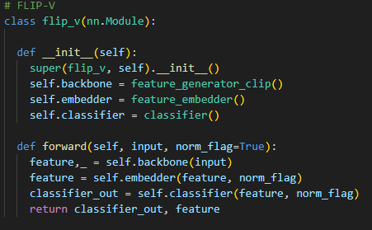
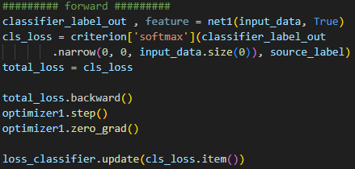
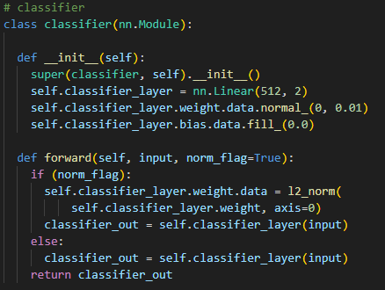
Image Encoder
optimizer1 = optim.Adam(optimizer_dict, lr=0.0001, weight_decay=0.000001) # LR = 1e-4
URINOV AZIZBEK (연구원), 2025.02.07, KII-FAS SEMINAR

Slide 16
4. What is FLIP_IT (FLIP-Image-Text Similarity) strategy ?
URINOV AZIZBEK (연구원), 2025.02.07, KII-FAS SEMINAR

Slide 17
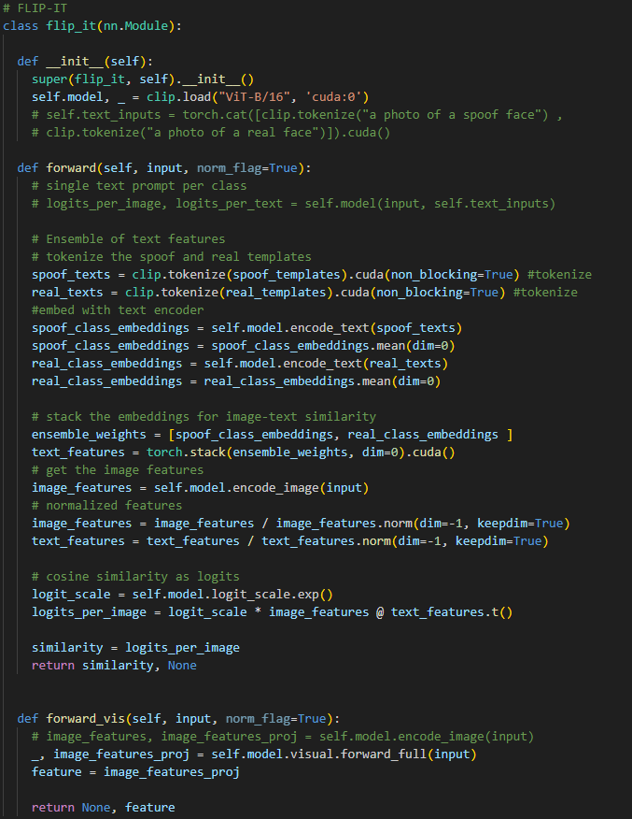
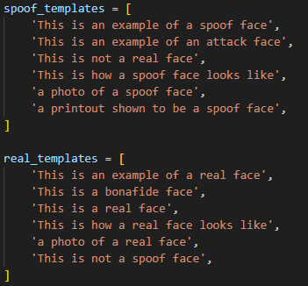
optimizer1 = optim.Adam(optimizer_dict, lr=0.0001, weight_decay=0.000001) # LR = 1e-4
URINOV AZIZBEK (연구원), 2025.02.07, KII-FAS SEMINAR

Slide 18
5. What is FLIP_MCL (FLIP-Multimodal-Contrastive-Learning) strategy ?
URINOV AZIZBEK (연구원), 2025.02.07, KII-FAS SEMINAR

Slide 19
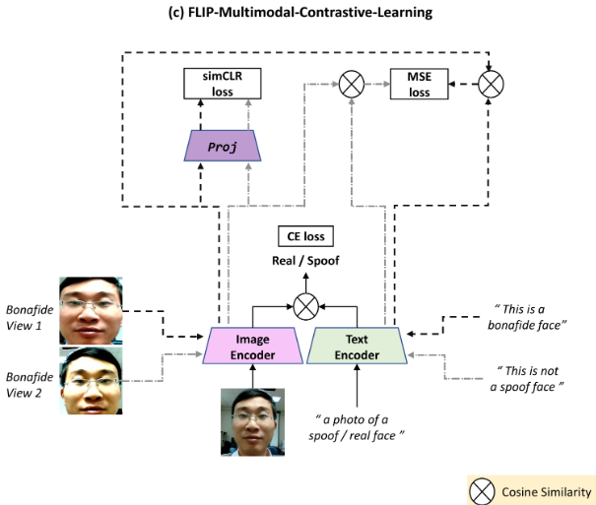
Mean Squared Error - minimize the error (minimize the difference between SimCLR proceed image features and text-based features from Text Encoder)
Contrastive Learning - helps to understand 2 real/spoof faces are same feature in feature space
Cross-Entropy Loss - decision making
Projection Head - transforms the features into space which SimCLR Loss can learn better.
URINOV AZIZBEK (연구원), 2025.02.07, KII-FAS SEMINAR

Slide 20
6. FLIP Framework Evaluation
URINOV AZIZBEK (연구원), 2025.02.07, KII-FAS SEMINAR

Slide 21
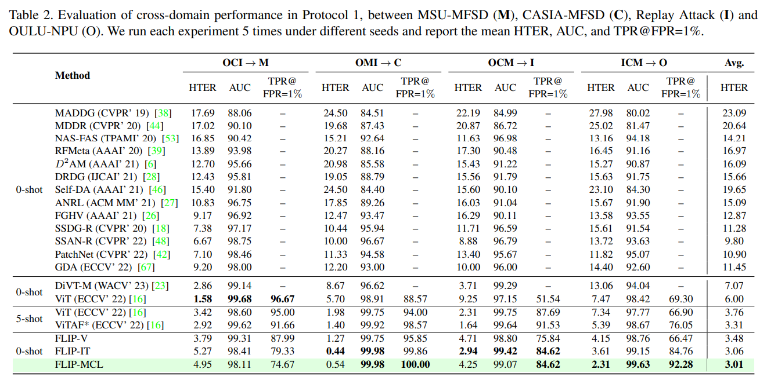
Extra info : I = 224 x 224 x 3, patch size = 16x16, Adam optimizer
URINOV AZIZBEK (연구원), 2025.02.07, KII-FAS SEMINAR

Slide 22
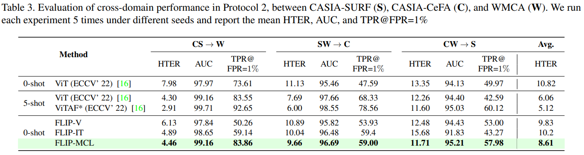
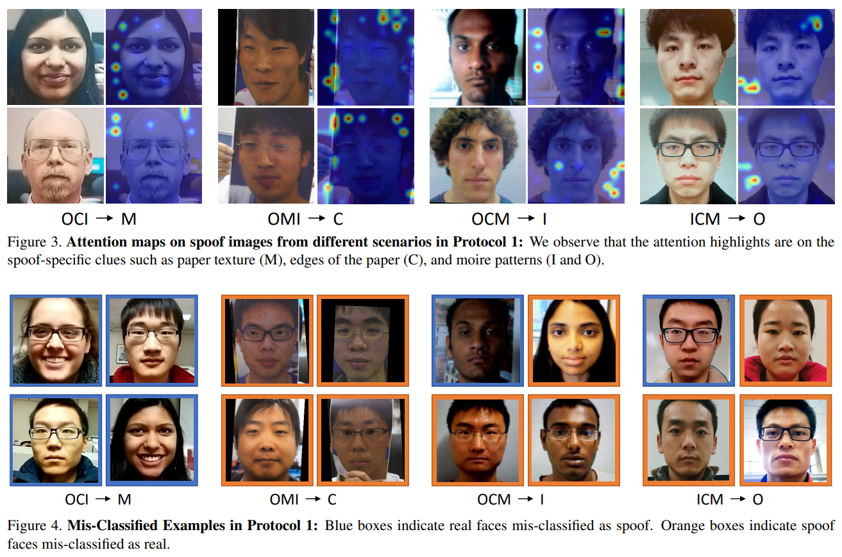
URINOV AZIZBEK (연구원), 2025.02.07, KII-FAS SEMINAR

Slide 23
7. Conclusion and Problems
URINOV AZIZBEK (연구원), 2025.02.07, KII-FAS SEMINAR

Slide 24
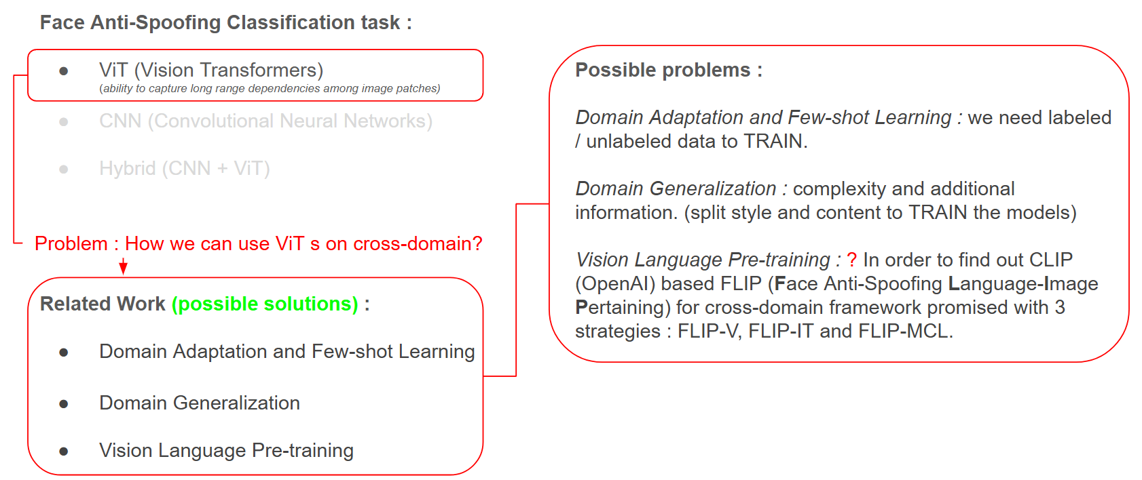
Problems with :
Pixelation
Extreme pose changing
Darker lighting conditions
High quality (spoof)
Model latacity
URINOV AZIZBEK (연구원), 2025.02.07, KII-FAS SEMINAR

Slide 25
THANK YOU
References :
CLIP paper: https://arxiv.org/pdf/2103.00020
CLIP code : https://github.com/OpenAI/CLIP
FLIP code : https://github.com/koushiksrivats/FLIP
FLIP paper : https://arxiv.org/pdf/2309.16649
Contact : uacoding01@gmail.com / suger01@korea-id.co.kr
URINOV AZIZBEK (연구원), 2025.02.07, KII-FAS SEMINAR

